Slide 1
LMRFC Reference Slide For Crest Tables
LMRFC Forecasts Issued Morning of May 11, 2022
Lower Mississippi
RIVER FORECAST CENTER
Talking Points
Significant rises on the middle Mississippi River above the confluence with the Ohio River have already peaked earlier this week. Minor flooding continues at Cape Girardeau, MO and Thebes, IL but both locations should fall below flood levels by the end of the week.
Rises are still occurring on the lower Ohio River and Cairo, IL is still forecast to crest slightly above flood stage at 40.5ft for Friday.
On the lower Mississippi River, rises are occurring from New Madrid, MO to Natchez, MS and the remainder of the lower Mississippi should see rises by this weekend.
Minor flooding is forecast at Natchez, MS by next weekend and Red River Landing, LA will rise above flood levels this weekend and crest on May 23rd near 51.0ft.
Crest levels on the lower Mississippi River are expected to be near or slightly higher than what occurred at the end of April and beginning of May.
The 16 day future rainfall guidance doesn’t show much additional rainfall so guidance levels are similar to the official forecasts for the lower Ohio and lower Mississippi Rivers.

Slide 2
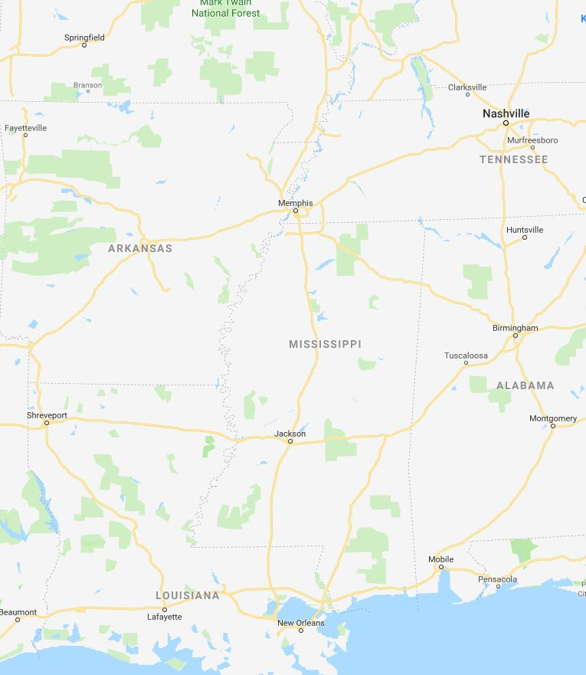
Ohio/Mississippi River Crest Watch
Created May 11 2022 @ 11:00 am CDT
Lower Mississippi River Forecast Center weather.gov/lmrfc
NWSLMRFC
@NWSLMRFC
MS River at Caruthersville
OH River at Paducah
Current: 27.2’
2 Days
Current: 27.4’
Forecast:
Rises over the next 5 days reaching ACTION by May 13th
Forecast:
Rises over the next 5 days
MS River at Memphis
2 Days
0.5 Day
OH River at Cairo
Current: 20.8’
Current: 38.6’
Forecast:
Rises over the next 5 days
Forecast:
Rises and cresting in MINOR at 40.5’ on May 13th
MS River at Ark City
5 Days
MS River at Greenville
Current: 28.7’
Current: 39.9’
Rises over the next 5 days
ACTION
Forecast:
Forecast:
Rises and remaining in ACTION over the next 5 days
2 Days
1 Day
MS River at Natchez
MS River at Vicksburg
Current: 44.3’
ACTION
ACTION
Current: 36.1’
Forecast:
Rises and cresting in MINOR at 48.8’ on May 22nd
Forecast:
Rises and remaining in ACTION
over the next 5 days
2 Days
MS River at Baton Rouge
2 Days
MS River at New Orleans
Current: 32.1’
Current: 11.1’
ACTION
Forecast:
Minor fluctuations over the next few days
Forecast:
Rises and remaining above
ACTION over the next 5 days
Bonnet Carré Location
Crest Location

